Slide 1
Machine Learning project presentation
REG NO: 12111298
ROLL NO: RK21UTB50
HYDROWATCH: WATER QUALITY PREDICTION
Here is the presentation begins
Presented by satwik uppada

Slide 2
TABLE OF CONTENT
Water Quality Monitoring System
Introduction
The Importance of Water Quality
How HydroWatch works
Key Water Quality Parameters Analysed by HydroWatch
Statistics and Sample Response
Data Understanding
Data Exploration and visualization
Graph
Guest Mode vs Registered Mode
Machine Learning Algorithms Training
Secure User Authentication with Firebase
The Future of HydroWatch: Continuous Innovation

Slide 3
INTRODUCTION
Water Quality Monitoring System
A revolutionary web application designed to empower you to take charge of your water quality. With HydroWatch, you can easily monitor and understand the safety of your drinking water, ensuring peace of mind for you and your family.

Slide 4
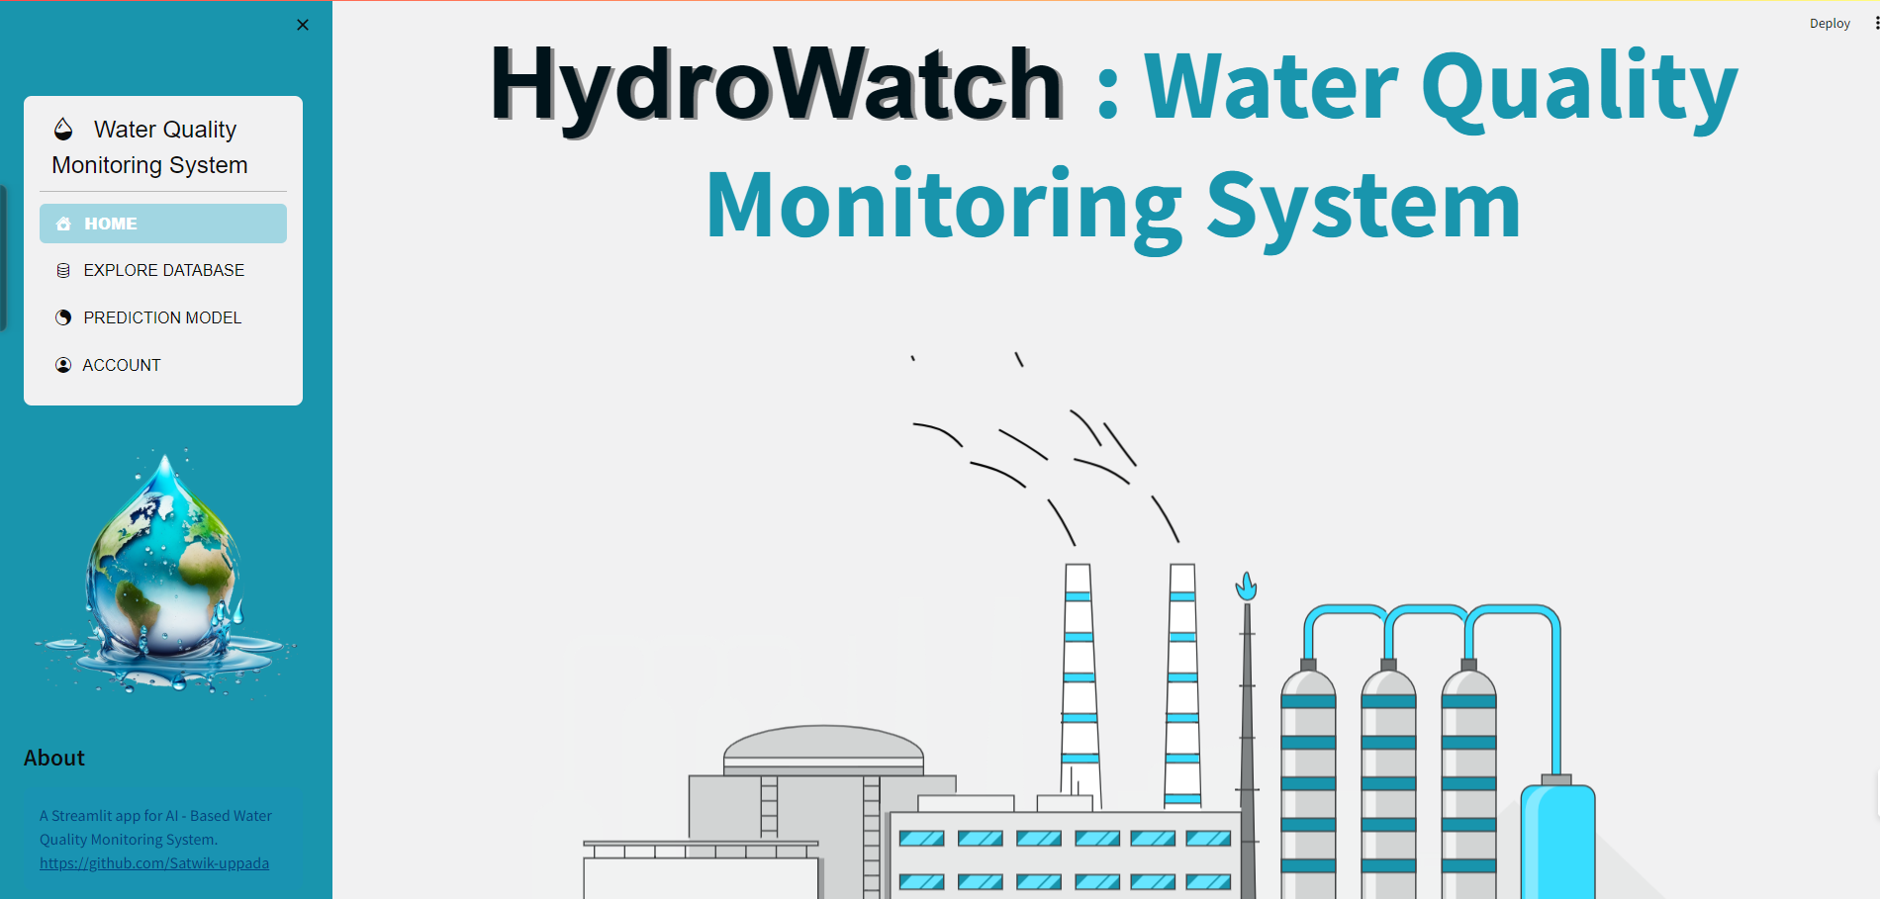
The Importance of Water Quality
Water Quality Monitoring System
Clean water is essential for life.
Contaminated water can lead to various health problems.
Monitoring water quality helps ensure its safety.

Slide 5
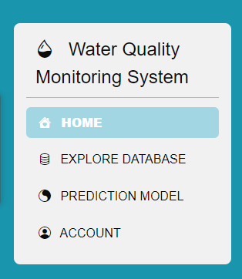
How HydroWatch works
Water Quality Monitoring System
Simple and user-friendly interface.
Enter water quality parameter values.
Powerful AI model predicts water safety.
Tells about HydroWatch
Give wings to explore the dataset that used in this project
Predict the Water quality
Creating account to new user/ login to existing user

Slide 6

Key Water Quality Parameters Analysed by HydroWatch
Water Quality Monitoring System
Parameters: 'aluminium', 'ammonia', 'arsenic', 'barium', 'cadmium', 'chloramine’, 'chromium', 'copper', 'flouride', 'bacteria', 'viruses', 'lead’, 'nitrates', 'nitrites', 'mercury’, 'perchlorate', 'radium', 'selenium’, 'silver', 'uranium'
Libraries Used:
Pandas
NumPy
Scikit-learn
Streamlit
Langchain_groq
Pygwalker
Pandasai
Matplotlib
Seaborn
Data Preprocessing:
Used IQR technique to handle outliers
Data is already standardized but imbalanced
To balance dataset, I used SMOTE oversampling technique to address overfitting.
Split the data into 80:20 ratio.

Slide 7
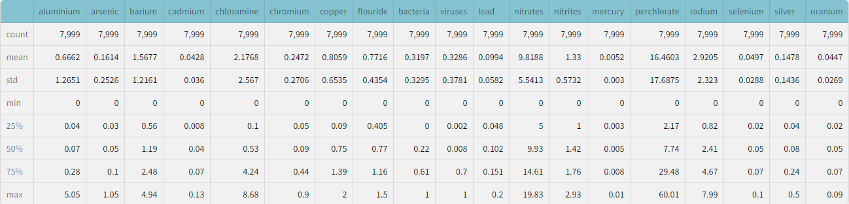
Descriptive statistics
Water Quality Monitoring System

Slide 8
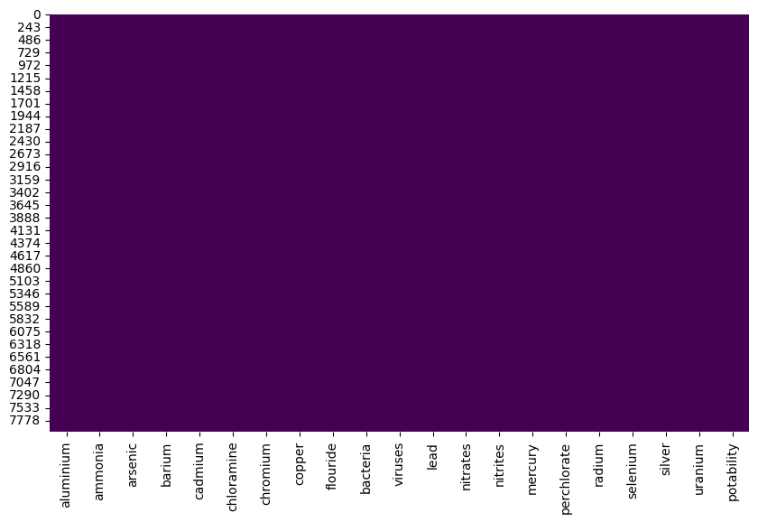
Data exploration
Water Quality Monitoring System
Null value detection
No NULL values observed in the dataset

Slide 9
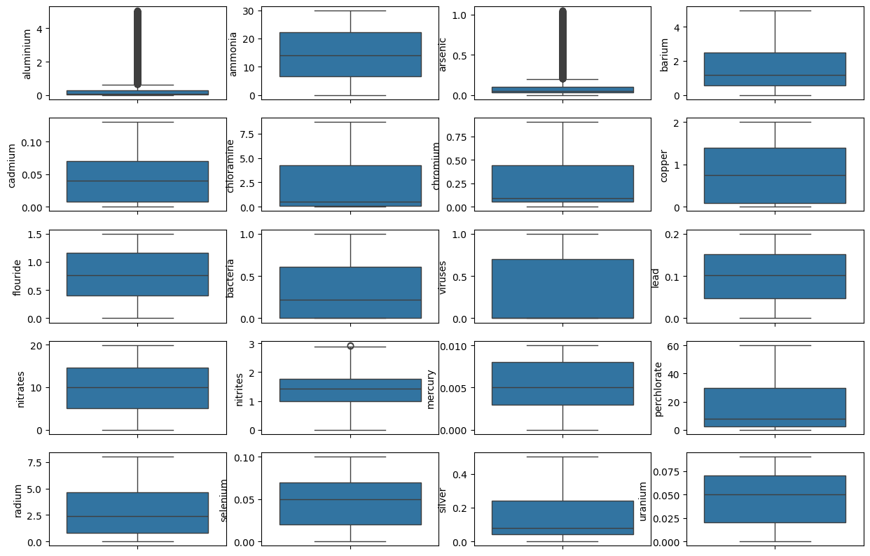
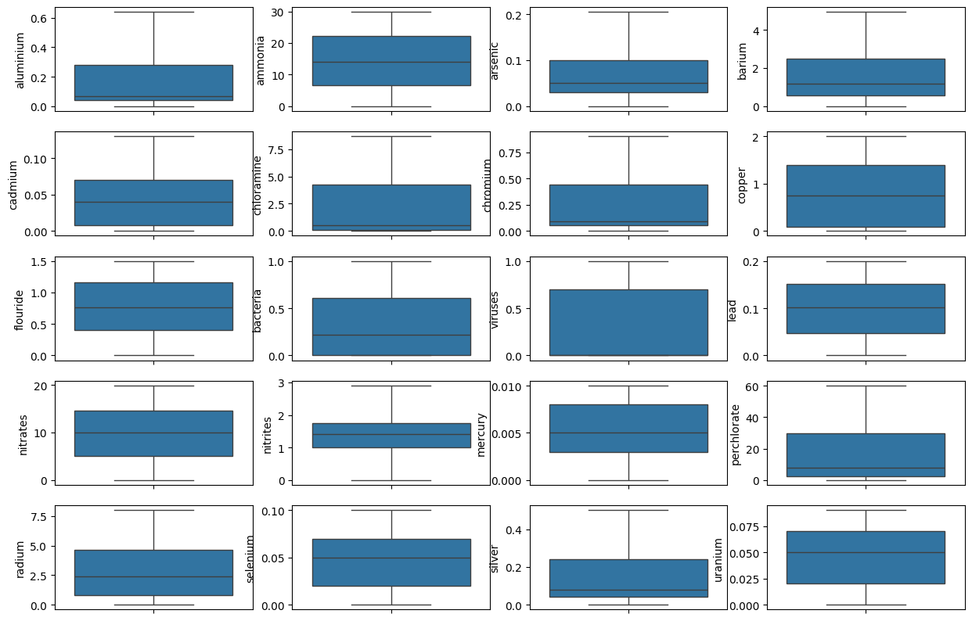
Water Quality Monitoring System
Outlier detection & handling
BEFORE
AFTER

Slide 10
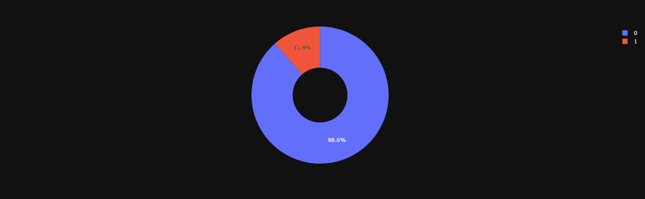
Water Quality Monitoring System
Data Distribution for each category
We can observe that dataset is imbalanced more number of 0’s and less number of 1’s are there
To address overfitting I used SMOTE Oversampling technique.

Slide 11
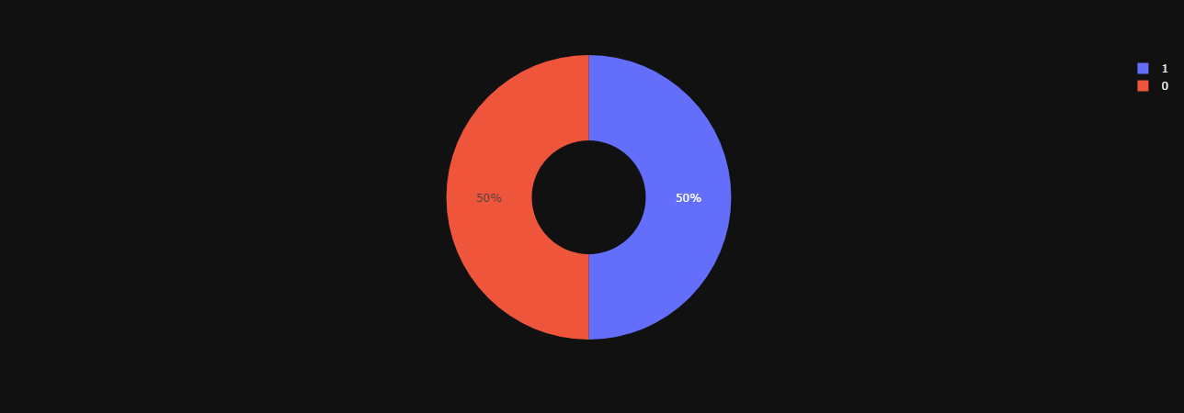
Water Quality Monitoring System
Data Distribution for each category
After using SMOTE technique. The data looks like this…

Slide 12
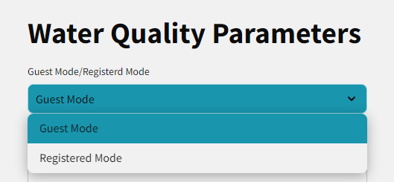
Water Quality Monitoring System
GUEST MODE AND REGISTERD MODE
Guest mode: Quick and easy prediction for immediate use.
Registered User: Store water quality data and access history (under development)
Personalized insights and trend analysis (Registered Only).

Slide 13
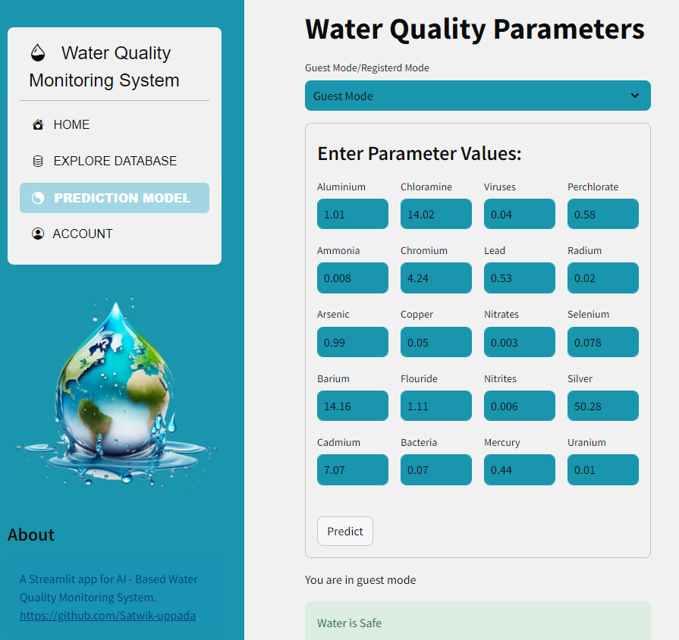
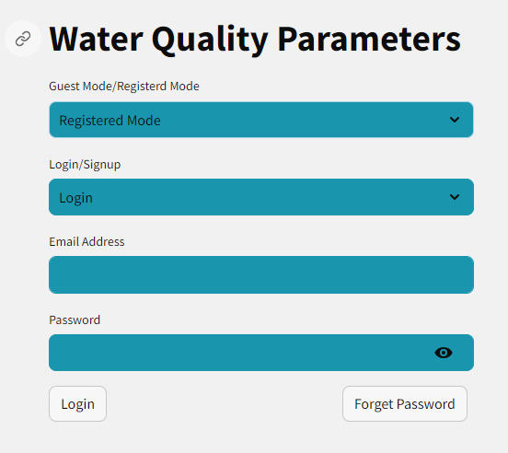
Water Quality Monitoring System
GUEST MODE
REGISTERED MODE

Slide 14
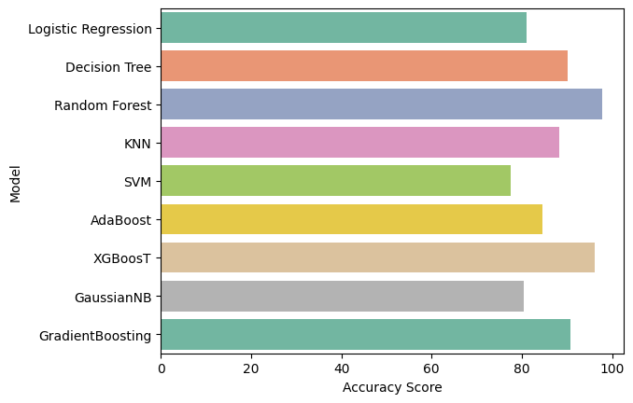
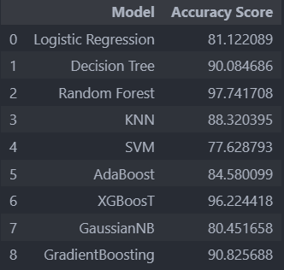
Water Quality Monitoring System
Machine learning algorithms used

Slide 15
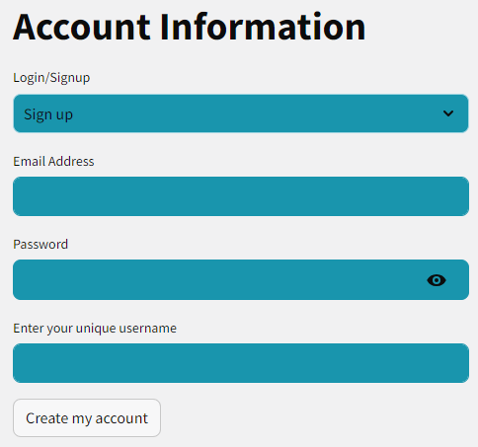
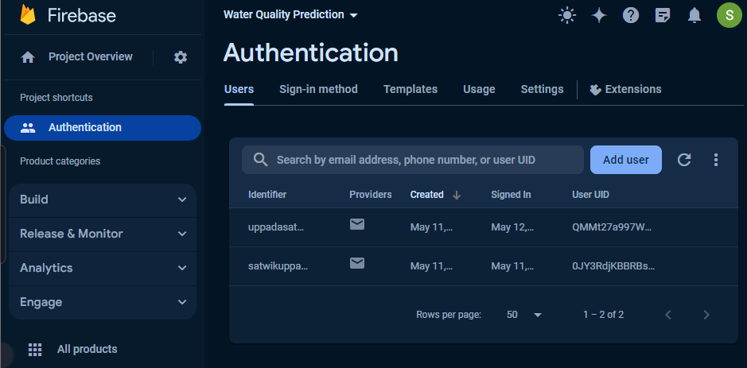
Water Quality Monitoring System
User authentication using firebase

Slide 16
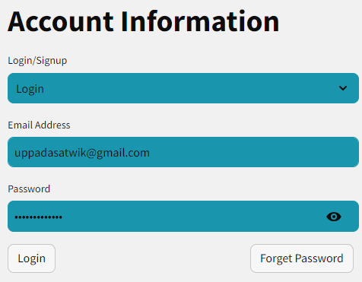
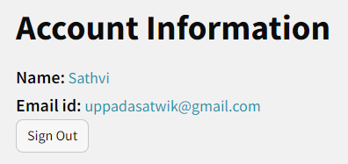
Water Quality Monitoring System
User authentication using firebase
AFTER LOGIN

Slide 17
Water Quality Monitoring System
User authentication using firebase
AFTER LOGIN

Slide 18
Summary
Water Quality Monitoring System
This web application monitors water quality by allowing users to enter key parameters and predicting water safety using a machine learning model.
It addresses class imbalance in the data (potentially indicating safe vs. unsafe water) to improve prediction accuracy.
The user-friendly interface empowers individuals to take charge of their water quality through informed decision-making.

Slide 19
Water Quality Monitoring System
Future takeaways
Database Integration: Store user data (water quality parameters and predictions) in a MySQL database linked to usernames for personal analysis.
Data Visualization and Exploration: Enhance the visualization and exploration page to effectively display charts generated by your Large Language Model (LLM).

Slide 20
THANKS!
Water Quality Monitoring System
Do you have any questions?
uppadasatwik@gmail.com
+91 8247068881
Presented by satwik uppada
www.linkedin.com/in/satwik-uppada

